Slide 1
JDBC CODES AND OUTPUT SNIPPETS

Slide 2
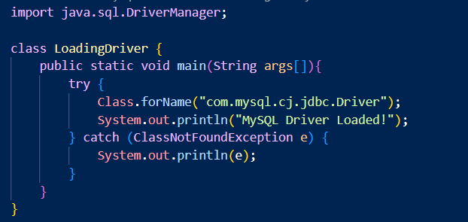
Program for Loading the driver [CODE]

Slide 3
Program for Loading the driver [Output]

Slide 4
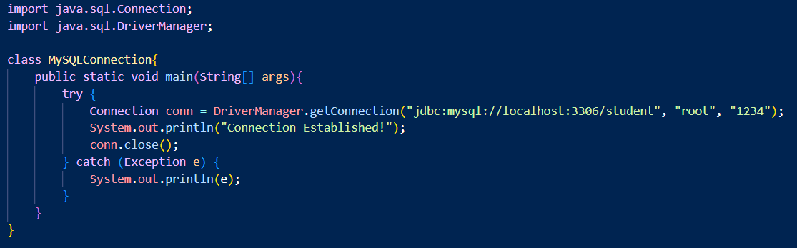
Program for Connect Database or Establish connection [CODE]

Slide 5
Program for Connect Database or Establish connection [OUTPUT]

Slide 6
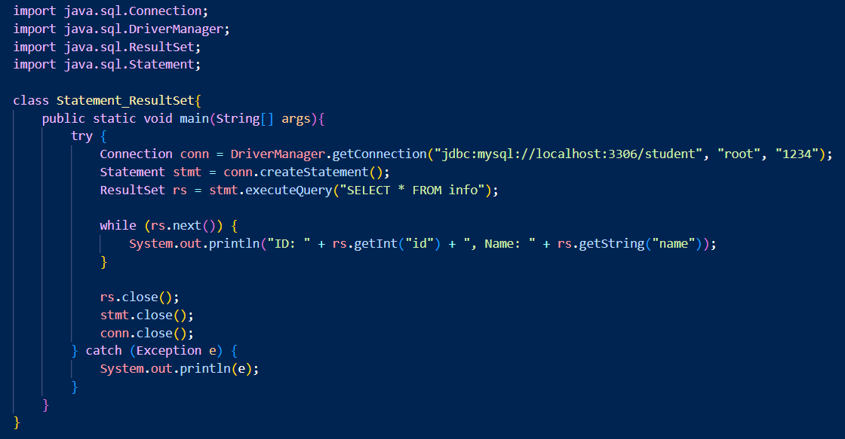
Program for Statement and Resultset Interface [CODE]

Slide 7
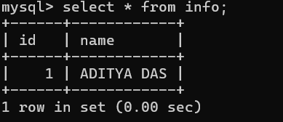
Program for Statement and Resultset Interface [OUTPUT]
MYSQL DATABASE DATA

Slide 8
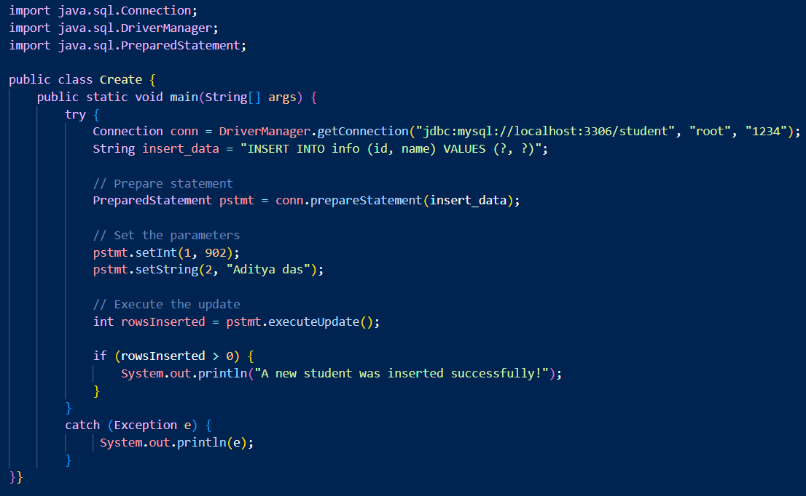
Program for PreparedStatement
Insert Data in DATABASE [CODE]

Slide 9
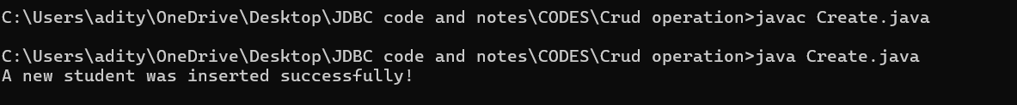
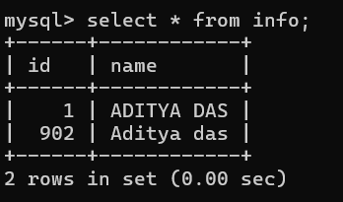
Program for PreparedStatement
Insert Data in DATABASE [Output]
A NEW DATA IS ADDED IN MYSQL DATABASE

Slide 10
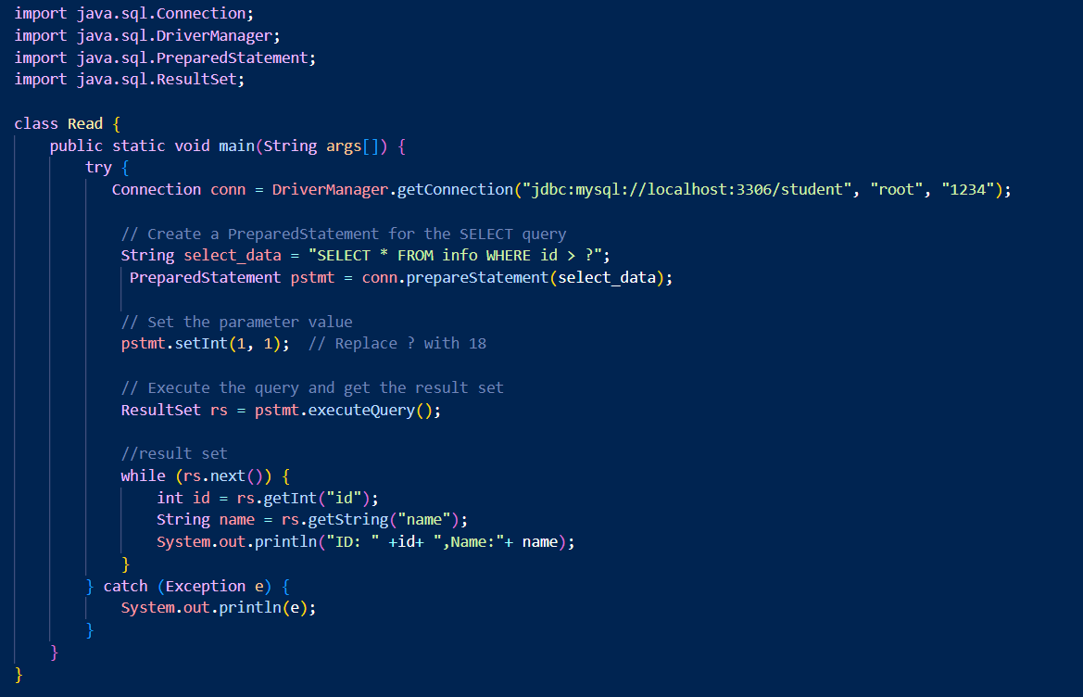
Program for PreparedStatement
Read Data in DATABASE [CODE]

Slide 11
Program for PreparedStatement
Read Data in DATABASE [Output]
MYSQL DATABASE DATA

Slide 12
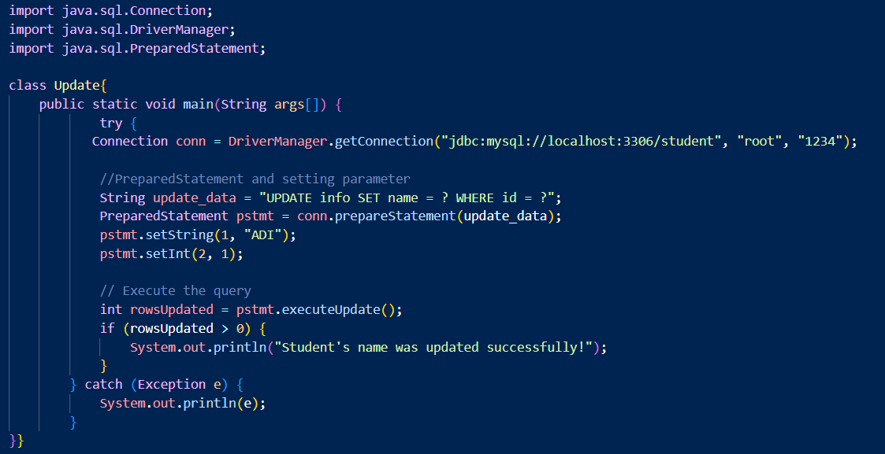
Program for PreparedStatement
update Data in DATABASE [CODE]

Slide 13
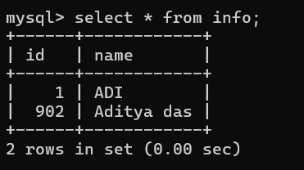
Program for PreparedStatement
Update Data in DATABASE [Output]
MYSQL DATABASE DATA (Previous)
MYSQL DATABASE DATA (NEW)

Slide 14
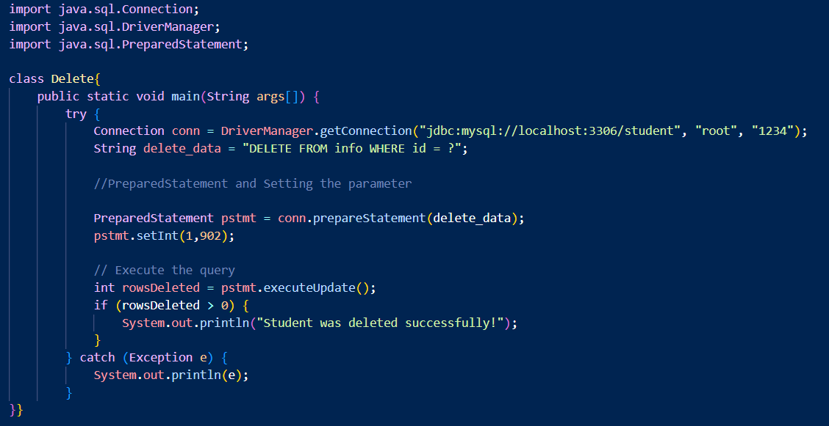
Program for PreparedStatement
Delete Data in DATABASE [CODE]

Slide 15
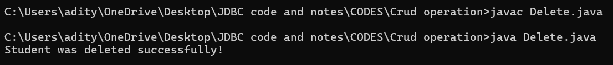
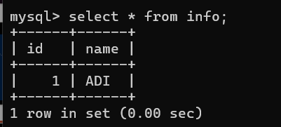
Program for PreparedStatement
Delete Data in DATABASE [Output]
MYSQL DATABASE DATA (Previous)
MYSQL DATABASE DATA (NEW)

Slide 16
Program for PreparedStatement
Delete Data in DATABASE [CODE]

Slide 17
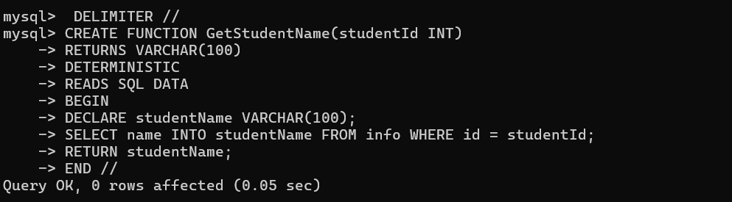
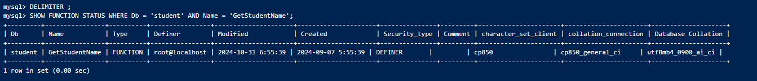
Program for CallableFunction (SQL-side) [CODE]

Slide 18
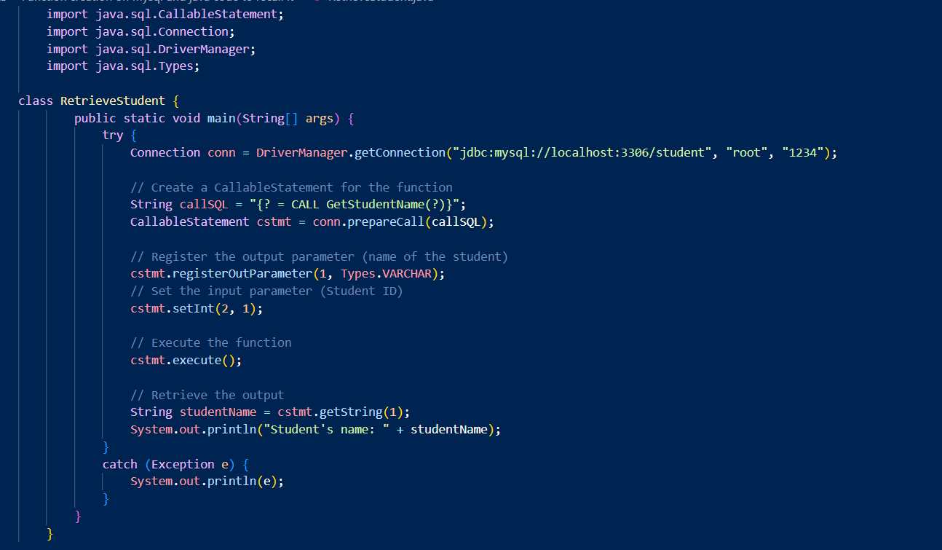
Program for CallableFunction (java-side) [CODE]

Slide 19
Program for CallableFunction [OUTPUT]

Slide 20
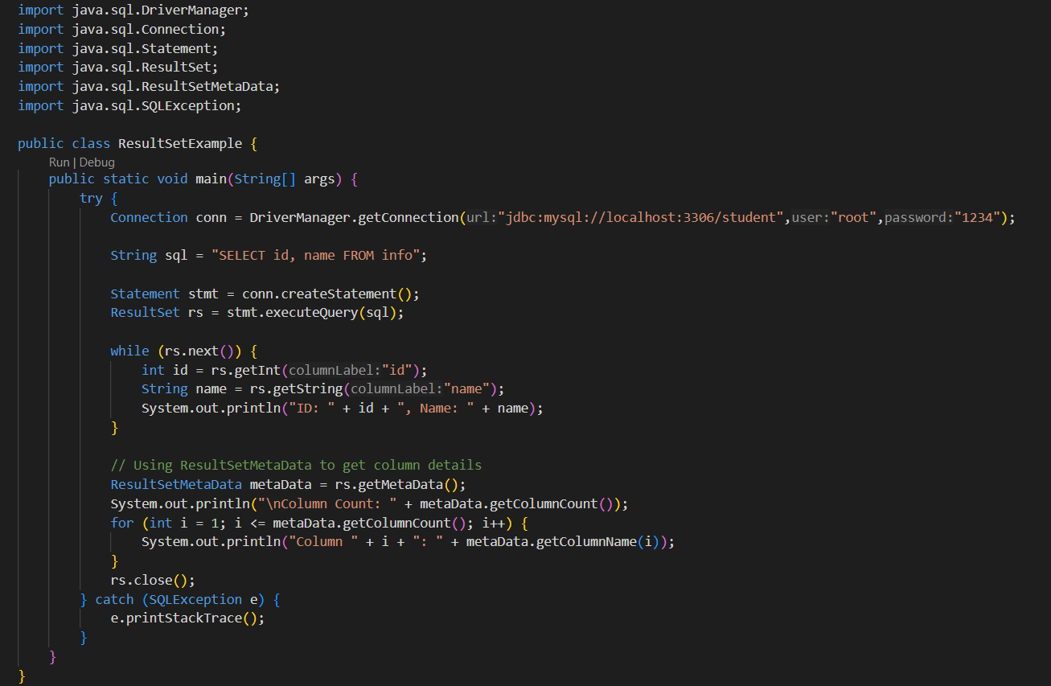
Program for ResultsetMetaData [CODE]

Slide 21
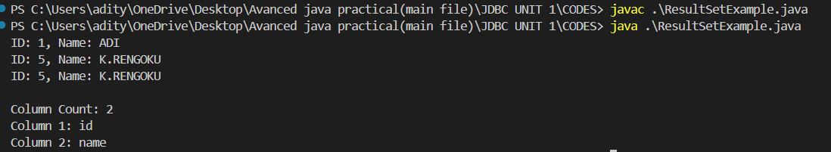
ResultSet [OUTPUT]

Slide 22
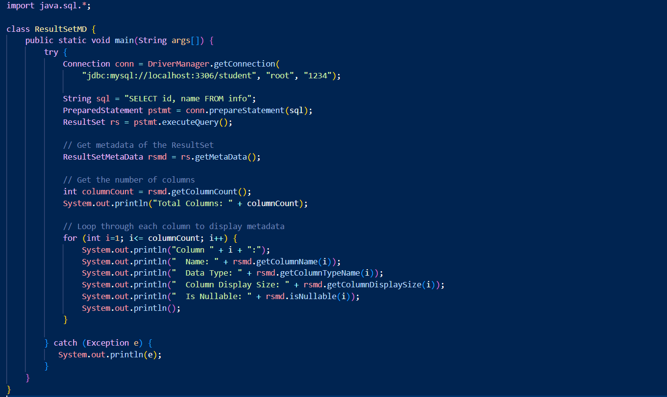
Program for ResultsetMetaData [CODE]

Slide 23
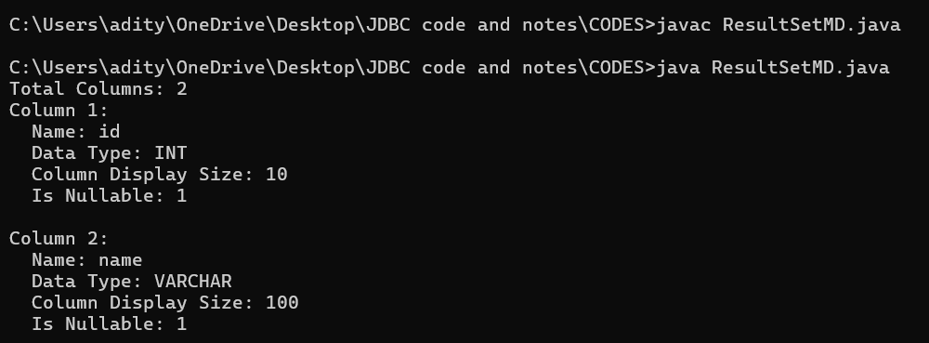
Program for ResultsetMetaData [OUTPUT]

